Slide 1
Project proposal
Kimberly Grauer

Slide 2
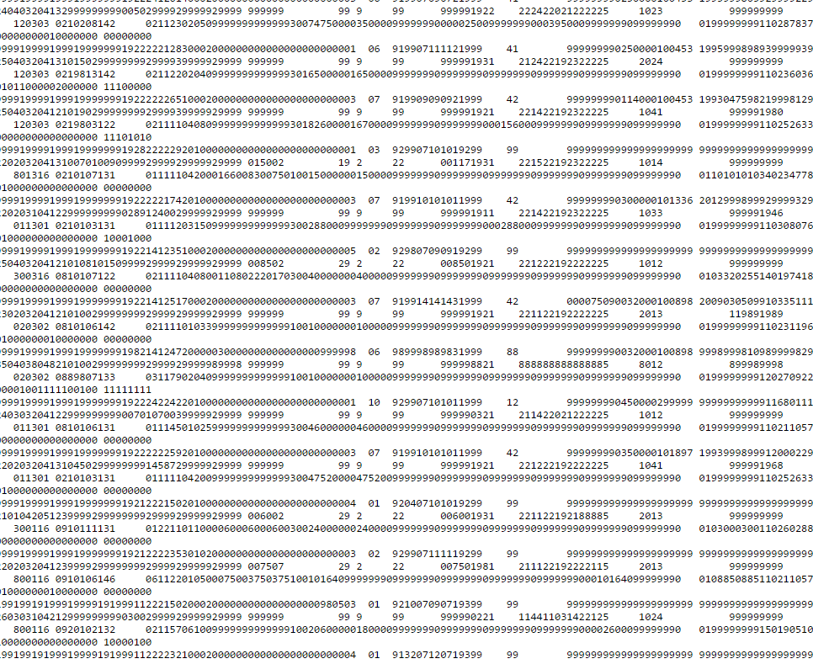
Project 1: Affordable housing in NYC
The problem: How has DeBlasio’s affordable housing initiatives effected the stock of rent regulated housing?
Data: Housing and Vacancy Survey
The data looks like ➔
Most recent is 2014
Time series not readily available online
Key questions:
What are the underlying trends in rent regulated apartments in NYC?
What are the correlations?
Is it possible to predict future rent-regulation trends?
Hypothesis: With greater advocacy by DeBlasio, there should be increased rent-regulated housing.
Previous studies:
Furtman Center analyzes housing stock trends but provides little analysis of underlying trends or explanations
John Krauss’ blog “Whither rent regulation” looks at trends over time, but with a different data source, the DOF property records (http://blog.johnkrauss.com/where-is-decontrol/)

Slide 3
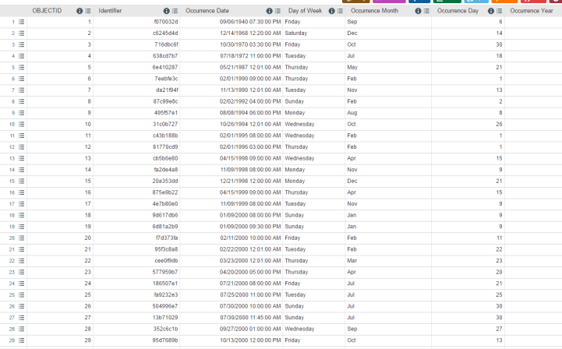
Project 2: Crime in NYC
Question: What causes major spikes in crime around NYC?
The Data: NYPD CompStat and NYC Open Data
Hypothesis: There will be consistent exogenous factors, such as time of day or weather or season, that influence crime rates
Previous studies:
I quant NY- looked to trends using the open data initiative (http://iquantny.tumblr.com/post/136641945194/your-neighborhoods-crime-rank-insights-from-the)
Data looks like

Slide 4
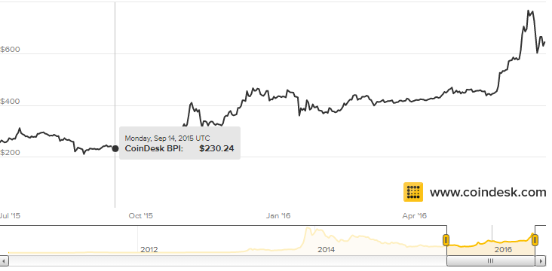
Project 3: Alternative Currencies
This project is slightly less feasible, with few data sources
Alternative currencies are increasingly popular, Bitcoin, Altcoin, Litecoin
What are the major correlates with raises in Bitcoins value?
Problem: We don’t understand what causes the major spikes and declines in bitcoin value
The Data: exchange rates and purchasing price of bitcoins using Coinbase version 2 API.
Hypothesis: major market fluctuations should lead to surges in Bitcoin value, with events such as Brexit causing spikes.

